Slide 1
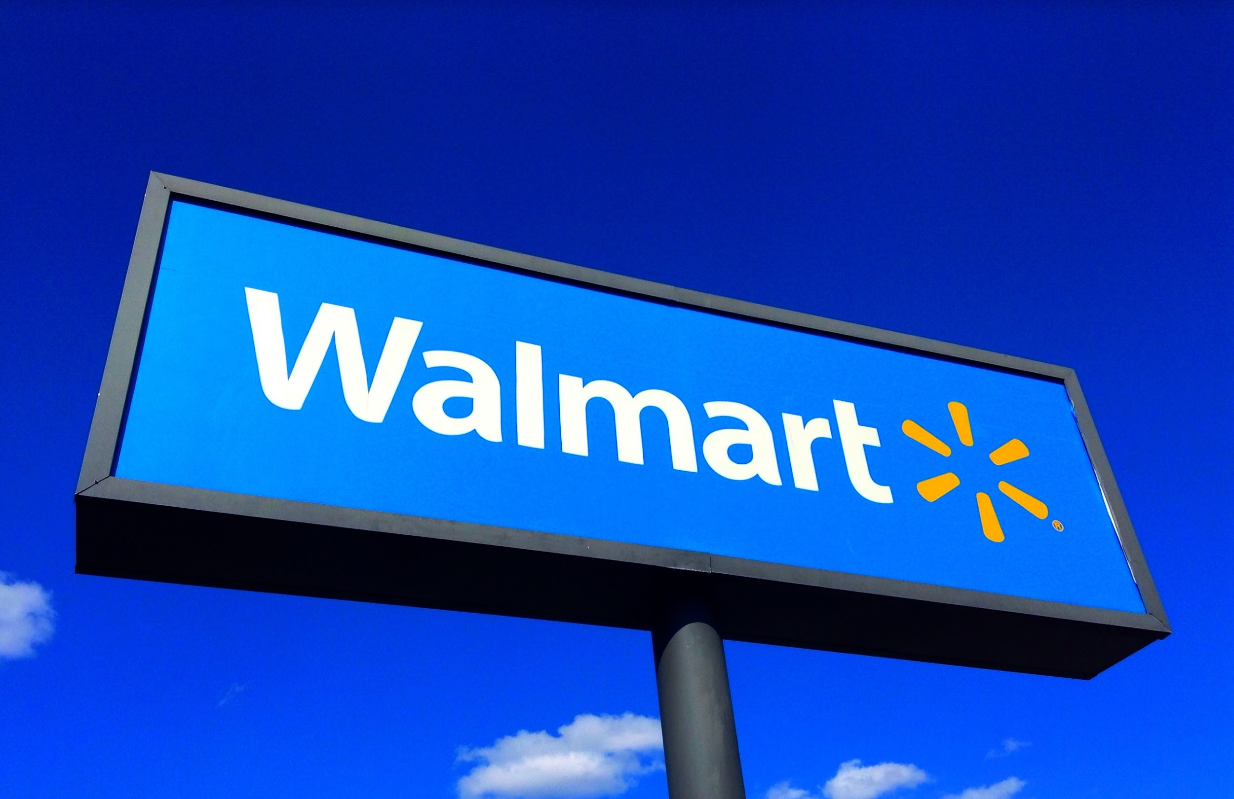
ISAD : Project proposal
Group 6 - Anjali Gupta, Surbhi Zambad, Yue Ma, Yining Ou

Slide 2
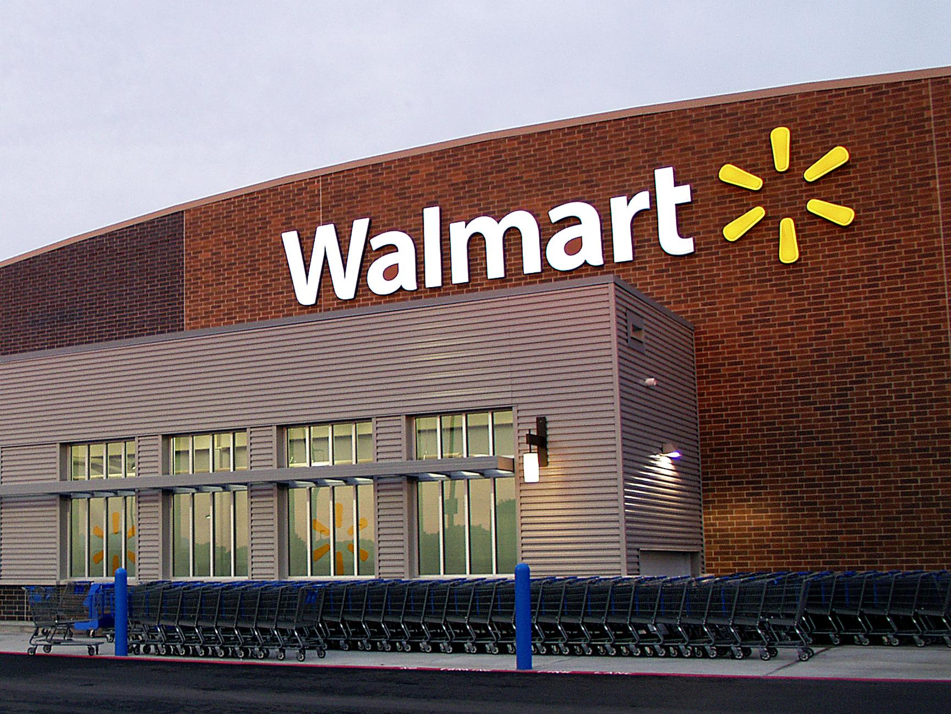
Introduce & Innovation
A shopping experience where the system helps both the supplier and the customer to sell or buy any kind of goods, the manager can maintain the inventory, the customer can compare the prices and quality of same products from different suppliers and choose the best mode of delivery.

Slide 3
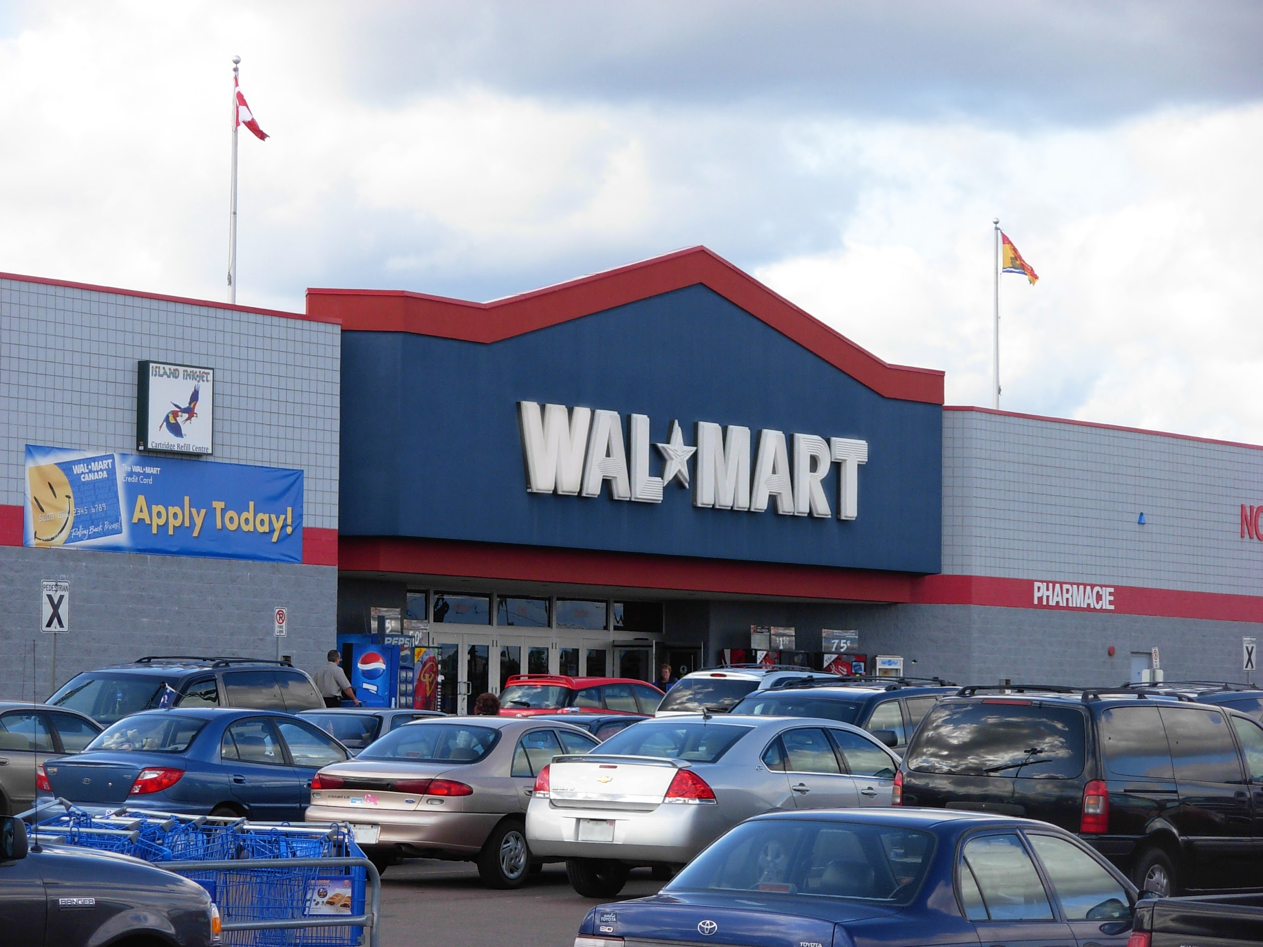
Business requirement & Business value
Business Requirements: online shopping, driving -through, in-store, seller system, inventory system.
Business Value : This system will allow the user to order products for a less price compared to its competitors online from anywhere in the country and facilitate doorstep delivery. It will also allow the user to pick up orders from the nearest Walmart store. It benefits the organization by increasing the sales of the items which will increase the profit for the Walmart systems, increasing the revenue and expanding the network worldwide. The system will also provide a seller management system which allows Walmart to manage sellers directly

Slide 4
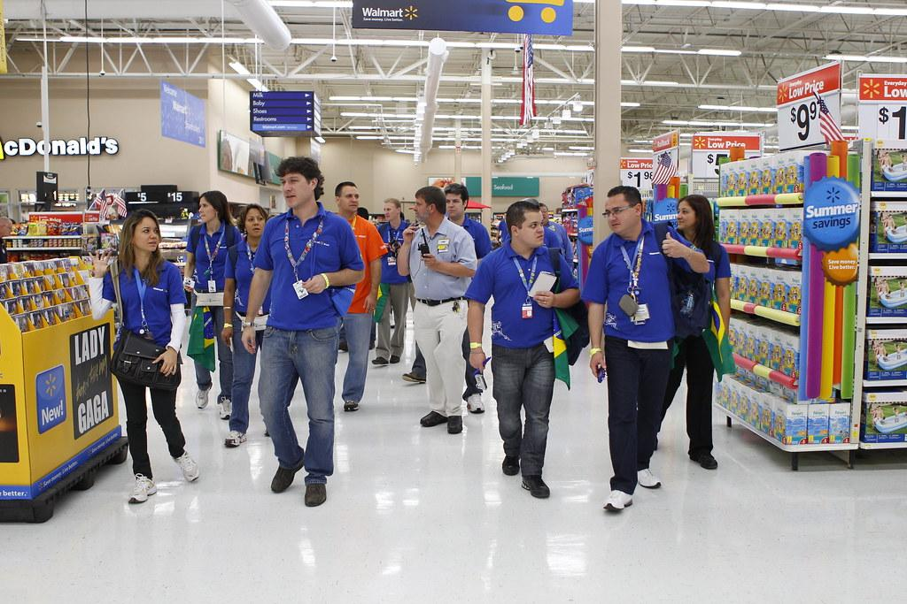
Functional requirements
Process requirements
Browsing the items online
For pickup or in-store shopping, browsing the nearest locations of the Walmart store
The system will allow user to create the account or login in the system
The system will allow the user to select the items sold by different vendors
Users can add the items to the wishlist or to the cart
Users can add or delete the quantity, choose the color and size of the product
System will allow the user to read or add the review of the product.
System will allow the user to add and modify address , contact and billing information in the system and recover it.
System will allow the user to select the pickup and delivery time of the order
System will give the notification of the new items introduced
System will allow the user to connect to the customer service
System will give timely notifications of the status of the order along with the tracking number
System will allow the user to return or modify the order within 30 days of the order placed
System will notify the manager to update the inventory

Slide 5
Functional requirements
Information requirements
Walmart centers and locations all over the region
The system stores the items present in the inventory in a particular location
Delivery and pickup information
Order history of the user
Account details and billing information of the user
Constantly updating of the inventory items
Offers and deals information on the products and their quantity
Reviews and ratings of the customer
Seller information
Product details and specifications
Cart items and wish list of the user

Slide 6
Nonfunctional Requirements
Operational
The system should be able to run on web browsers – Firefox, Google Chrome, Edge, and Internet Explorer, Safari
The system should be able to integrate with the existing inventory system.
The system should support English and Spanish.
Performance
The system should be available for use 24 hours per day, 365 days per year.
The system should not exceed more than 2 seconds between the user and the system.
The system downloads new status parameters within 5 minutes of a change.
The system supports 500 simultaneous users from 4-9 P.M.; 200 simultaneous users at all other times.
Security
The system must remain resilient in the face of attacks.
Customer information should be encrypted and only himself/herself can review his account information.
Only delivery staff can see the delivery address.
The system must be built following SOA web service security standards.
Payment information will be encrypted and secured.
Cultural & Political
No special cultural and political requirements are expected.

Slide 7
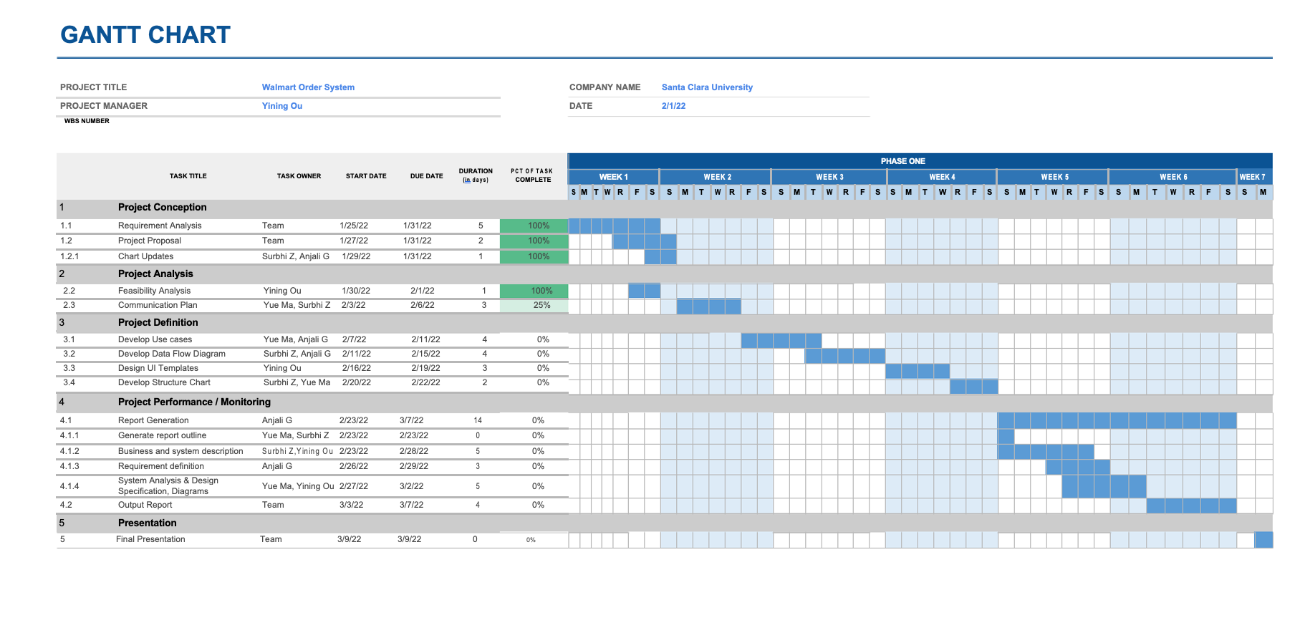
Work Plan
Notes:
Here is the Gantt Chart version of our project’s work plan. We divide our project into 5 parts. Project Conception, Project analysis, Project definition, project performance and final presentation. Until today we have finished the first task and work on the second task.

Slide 8
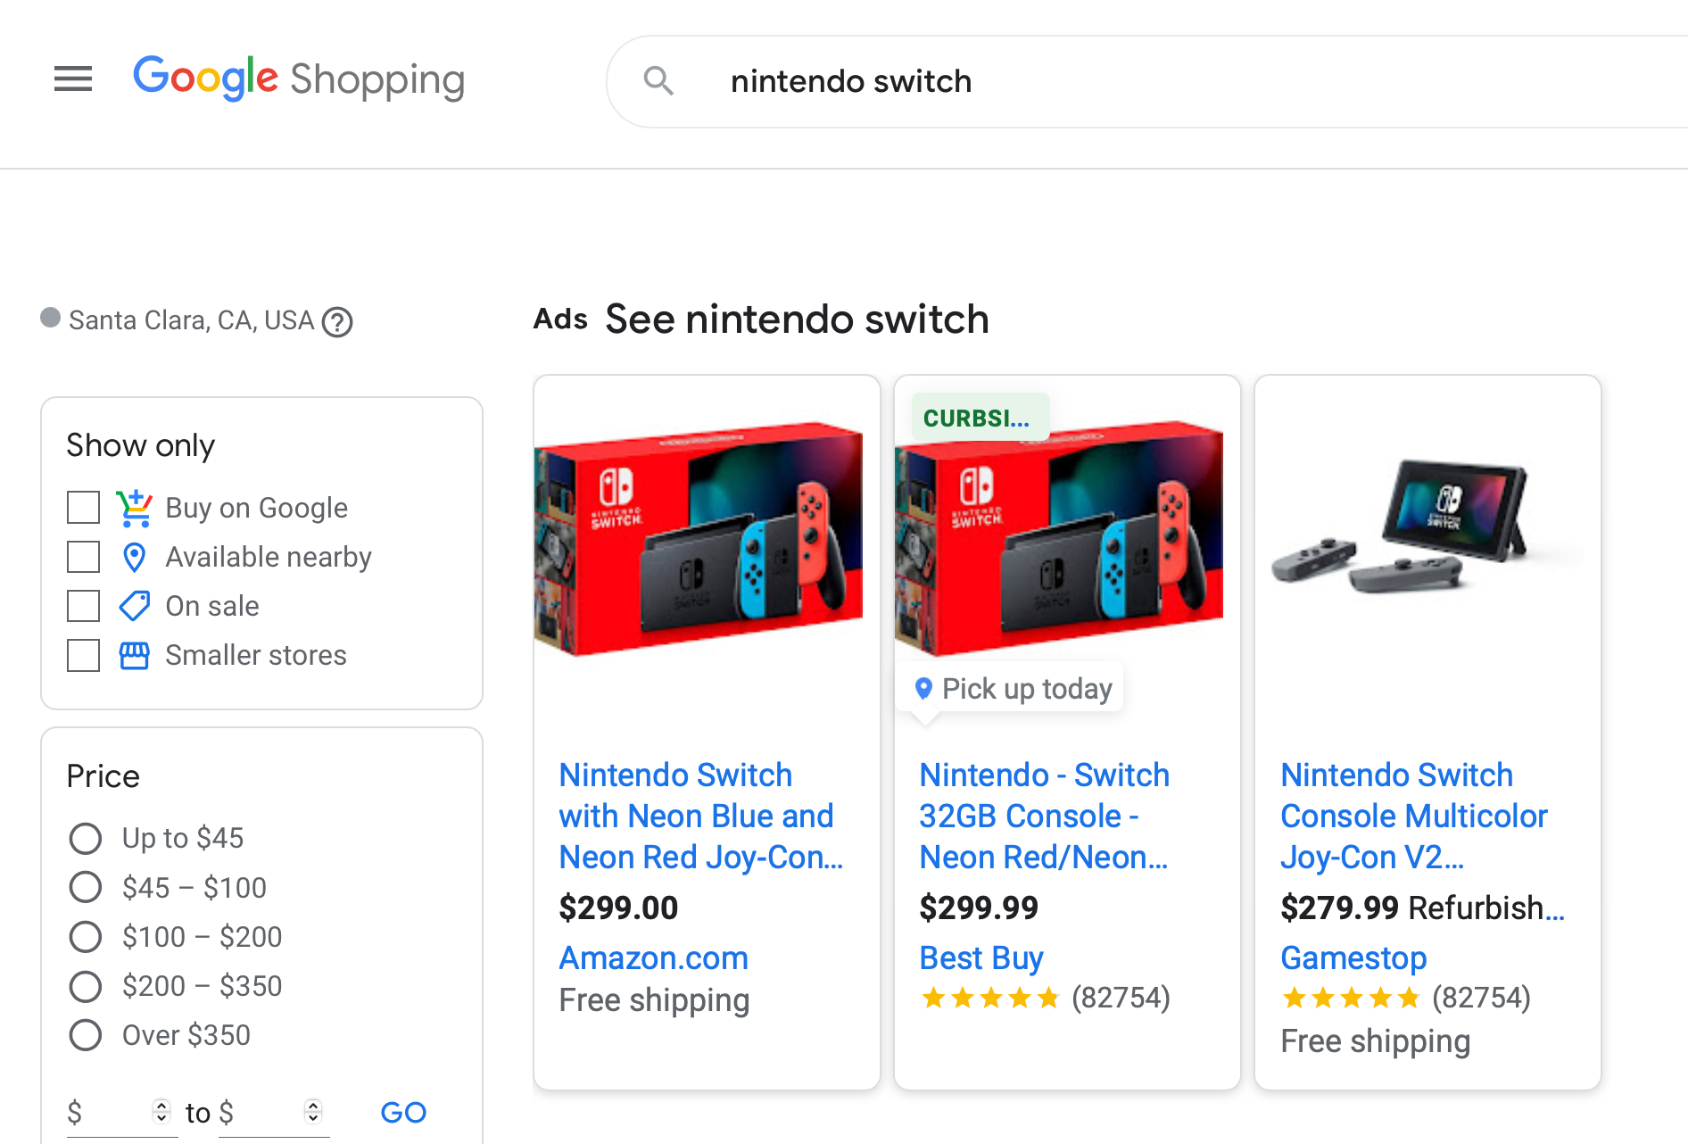
New Features
Price Comparison System
Notes:
When a customer searches for an item on Walmart's website, the competitor's price is also displayed. This can give customers a more intuitive feeling that products in walmart are cheaper and thus make them more willing to buy.
Questions:
Policy & Law concerns
Technical concern
We want to know if it reasonable and feasible

Slide 9
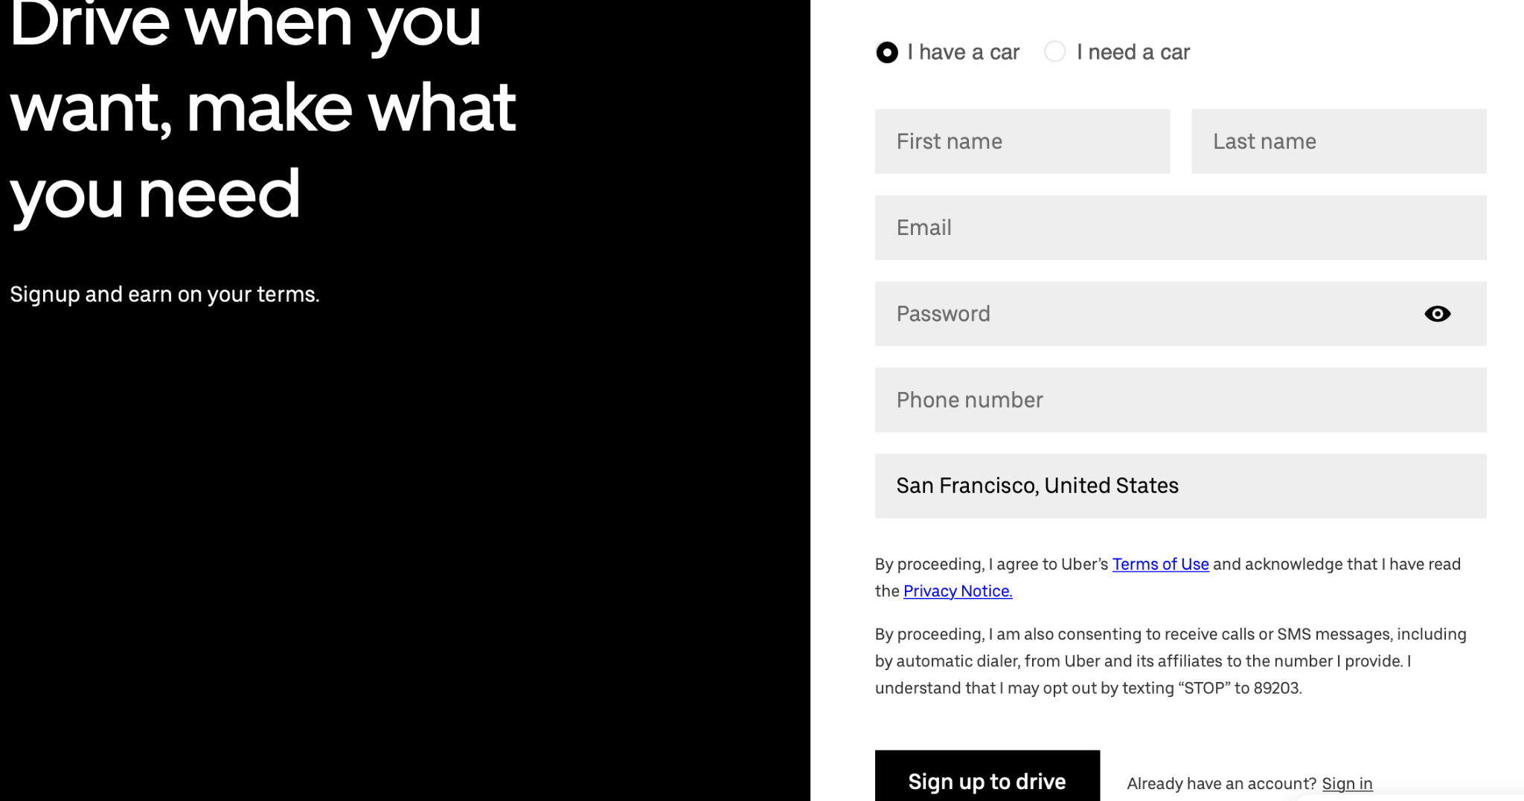
New Features
Allow Driver sign up as a independent delivery organization to help walmart delivery packages.
Notes:
Just like the amazon delivery service partner, Walmart can also use these independent delivery service organizations that help walmart deliver thousands of packages to customers, which can also increase the employment rate.
Third party

